Slide 1



Federal Institute of Paraíba
Welcome 歡迎 Bienvenue bienvenidos
Damires Souza
[damires@ifpb.edu.br]

Slide 2
Outline
IFPB
Courses
Some numbers
Innovation Pole
Laboratories
Considerations

Slide 3
Federal Institute of Paraíba
It is a federal public and free of charge institution.
Mission:
  Promoting teaching, research, extension and innovation activities
    Based on social inclusion of young people and adults
    Focus on job market oriented courses

Slide 4
Federal Institute of Paraíba
Some Knowledge areas:
  Electrical Engineering
  Computer Science
  Agroecology
  Environment
  Fishery
  Seamanship
  Mechanical Engineering
  Geosciences
  Chemistry
Teaching
Research
Extension
Innovation

Slide 5
How does it work?
People
  Teachers
  Students
  Technicians
Infrastructure
  Campuses + courses
  Labs + teaching rooms
Relationships
  Partnership with Industry
Learning
Outcomes
Impact on
Society

Slide 6

Pillars
Courses in several levels:
  Basic, technical, graduation and post-graduation
  Verticalization:
    to offer courses of the same fields in different levels, so that the students have the possibility to complete, without changing the institution, the graduating process since high school until the post-graduation;
Cooperative educational programs
Partnerships with institutions and companies
    Providing students with employment opportunities and specific learning outcomes.

Slide 7

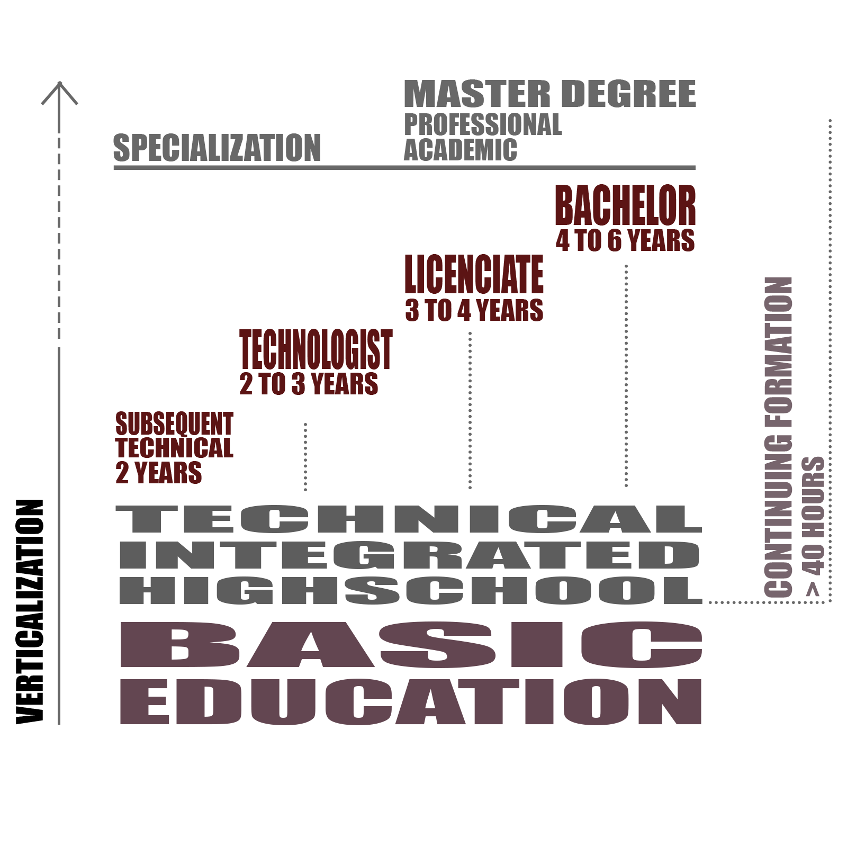
    Job market oriented courses
IFPB

Slide 8
Course Proposals - Lucena
The IFPB consolidated a Teaching Unit in Lucena
  Subsequent Technical
    Fishery
    Maneuvers and Deck Equipment
    Maintenance of Naval Machinery
  Continuous Formation
    Solid Waste Management Agent
    Port Logistics Operation Assistant
    Navigation
    Naval Propulsion Systems
    Auxiliary Naval Systems
  Pos-graduation programs
    In environmental control
    In waterway transportation

Slide 9

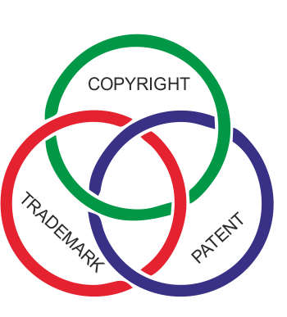

Some numbers
21 campuses
416 Phd and 119
MSc Professors
234 courses
181 Research
Groups
+ 31.000
students
1 Innovation Pole
41 patents and
37 software registrations

Slide 10
Innovation Pole
  Created to manage and execute innovation projects
    By meeting demands of productive chains
    Research, Development & Innovation;
    Professional training ;
    Technological services.
      Mainly in Manufacturing Systems
    Accredited by EMBRAPII – Brazilian Company of Research and Industrial Innovation

Slide 11
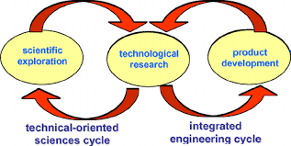
Main Idea
Companies receive technology innovation projects
x
IFPB receives real problems

Slide 12
Some Labs
Assert Lab
  Main lab associated with the Innovation Polo and its projects
Laboratory of Instrumentation, Control Systems and Automation (LINSCA)
Control and Automation Drives Laboratory (LACA)
  Electronics in power systems
Laboratory of Process Automation and Integrated Manufacturing
  Computational vision, robotics
Laboratory of Electronics
  Testing and development of electronic circuits
  FABLAB
    Laboratory being assembled by Polo for prototyping and designing projects

Slide 13
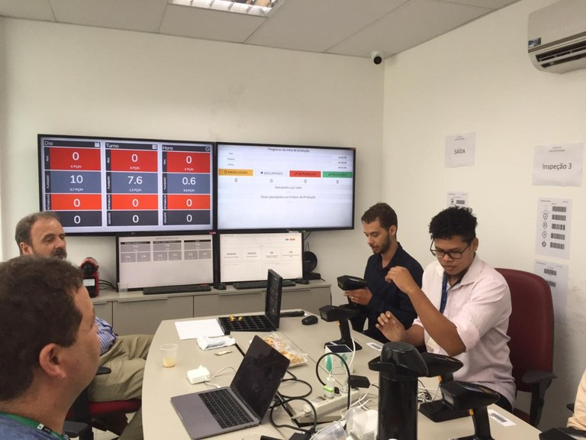
An example

Slide 14
Considerations
IFPB is a reference in professional education in the state of Paraiba, Brazil
It offers many courses
  With modalities integrated into high school, subsequent, higher education and post-graduation
It enables working with applied research, extension and innovation together with its learning process
  In accordance with the needs of the society and job market.

Slide 15

Federal Institute of Paraíba

